Slide 1



SEN4018 Project
Pima Indians Diabetes
Afaf Alalwan (1901077)
Charaf-Eddine M'rah (1900298)

Slide 2

Dataset Description
The Pima Indians Diabetes Databas is provided by The National Institute of Diabetes and Digestive and Kidney Diseases. This dataset is a subset of the larger dataset. In this dataset, all of the patients, are Pima Indian women who are at least 21 years old. The dataset contains 8 medical predictor factors.

Slide 3

Medical Factors:
Number of times pregnant
Plasma glucose concentration a 2 hours in an oral glucose tolerance test
Diastolic blood pressure (mm Hg)
Triceps skin fold thickness (mm)
2-Hour serum insulin (mu U/ml)
Body mass index (weight in kg/(height in m)^2)
Diabetes pedigree function
Age (years)

Slide 4
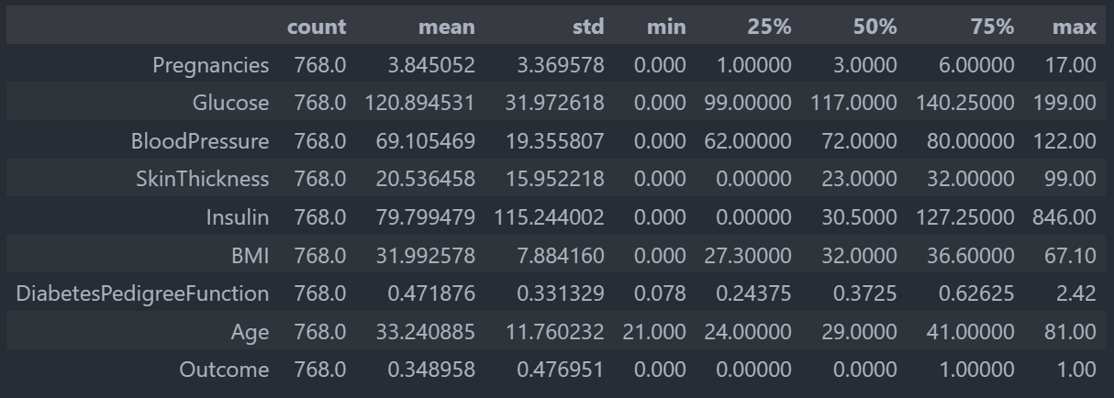
Statistical Description

Slide 5


Data Preprocessing
01
02
03
Step 1
Step 2
Step 3
Visualize raw data
Preprocess data
Visualize Preprocessed data

Slide 6

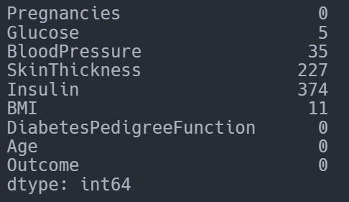
Missing Data
These values can't be zero, so missing data is converted to NAN:
Glucose
BloodPressure
SkinThickness
Insuling
BMI
Number of NAN values for each feature

Slide 7
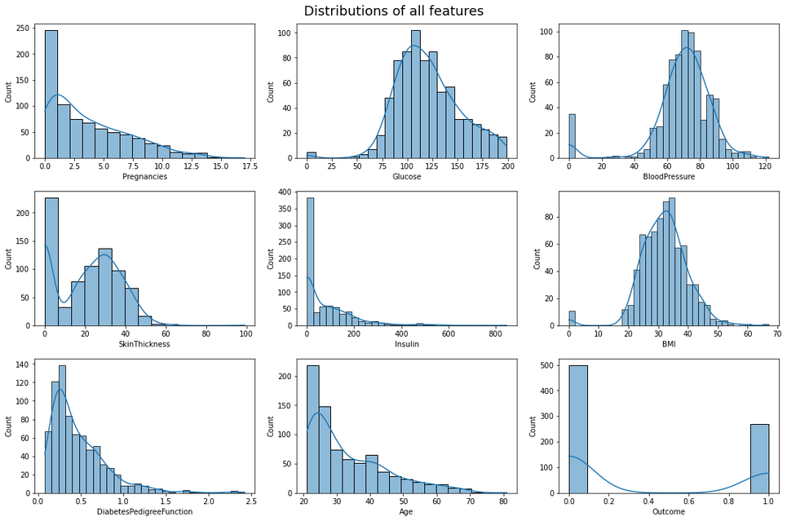
Features Distribution
This is the distributions of all features before imputation:

Slide 8
Features Distribution
NAN values were replaced with more suitable values:
Glucose -> mean
BloodPressure -> mean
SkinThickness -> median
Insulin -> mean
BMI -> median

Slide 9
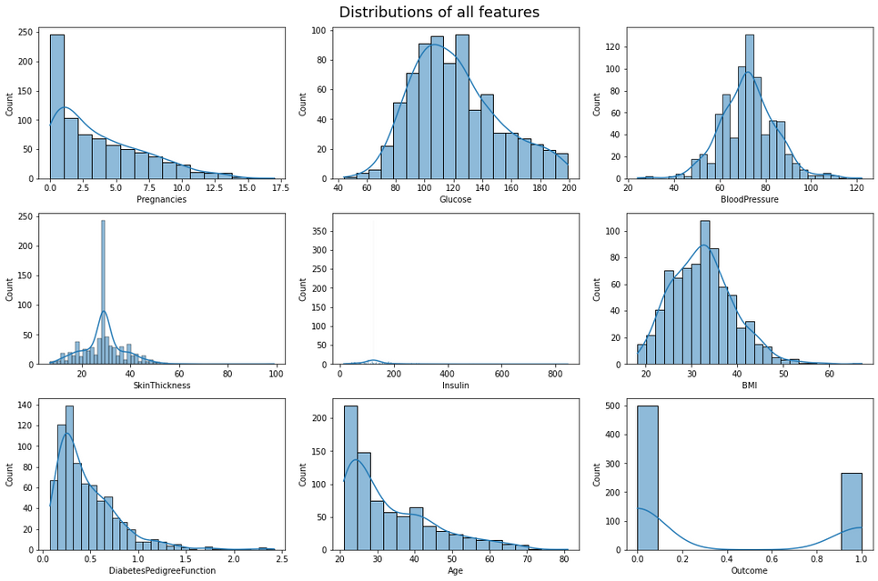
Features Distribution
This is the distributions of all features after imputation:

Slide 10

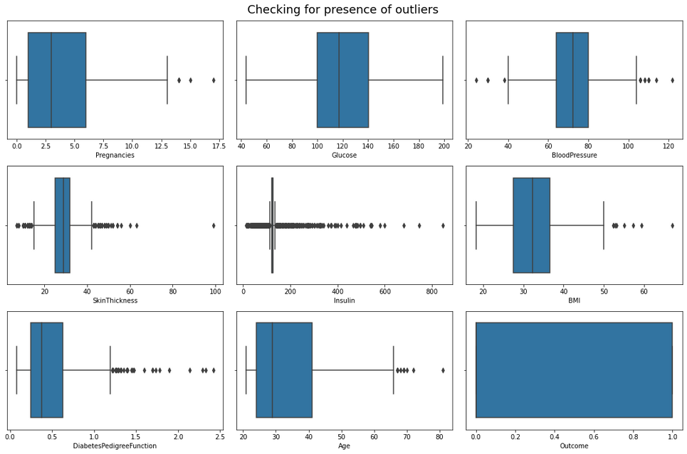
Checking for Outliers
We then used Box plots to visualize the outliers in our dataset.

Slide 11
Checking for Outliers
In our case, the outliers help improve the prediction accuracy of the logistic regression model, therefore we do not remove them.

Slide 12
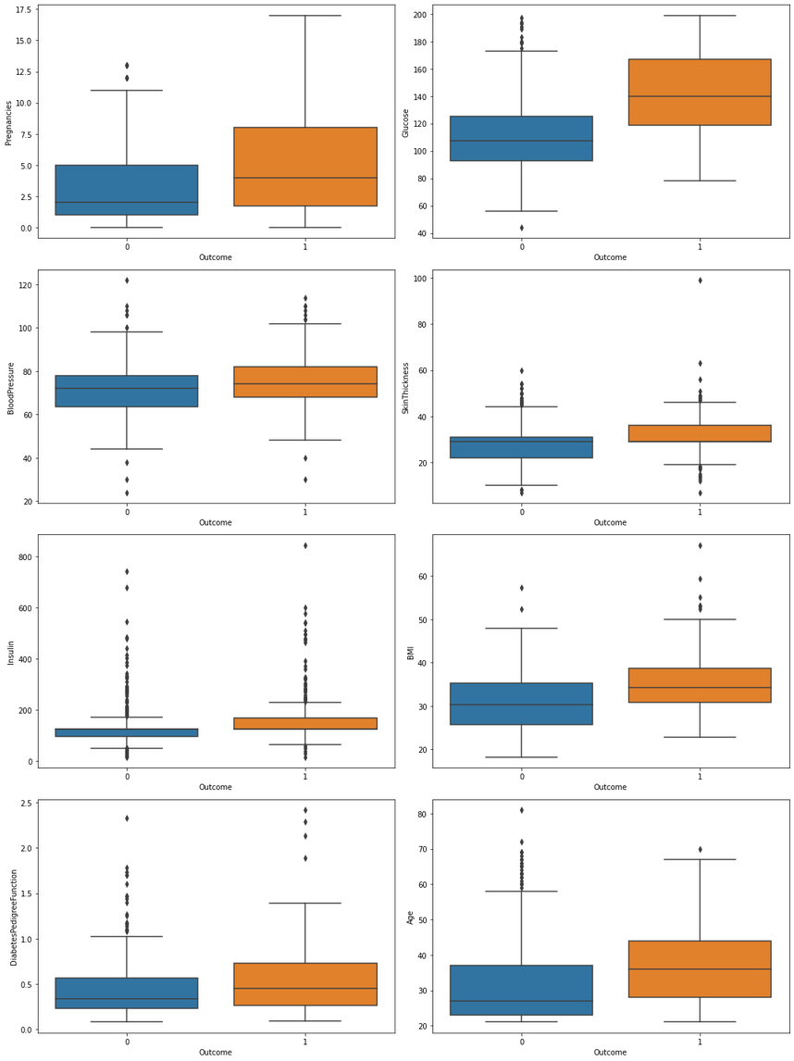
Predictor Features
We then plotted the predictor features against the dependent variable (Outcome) to check for correlations

Slide 13
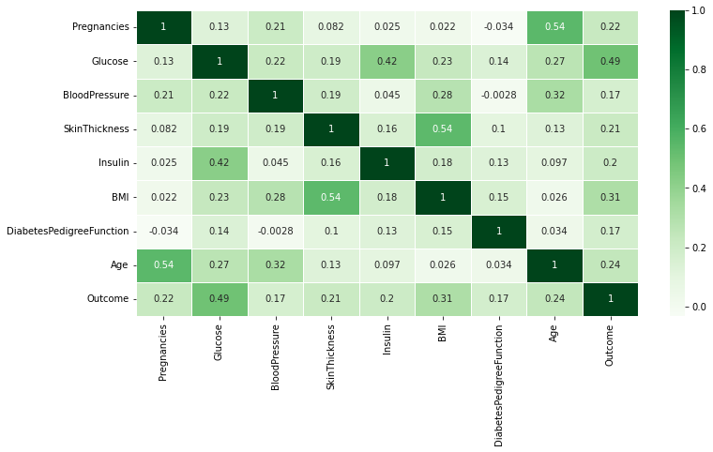
Heatmap
A heatmap of the correlation matrix:

Slide 14
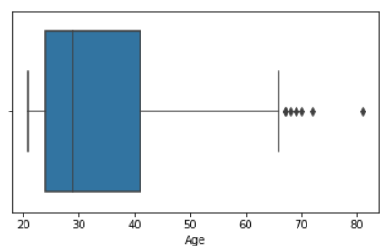
Major Findings
Outliers in terms of age, are usually women over 65.

Slide 15
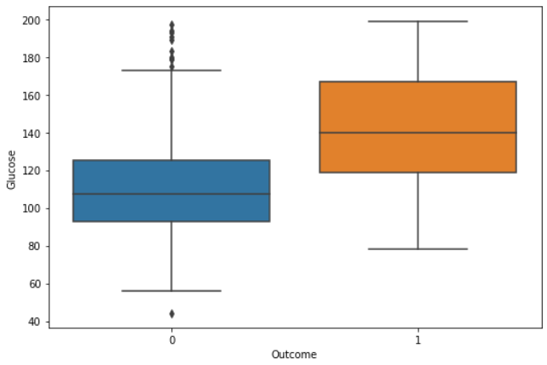
Major Findings
Glucose is a significant predictor for the outcome, especially positive cases.

Slide 16
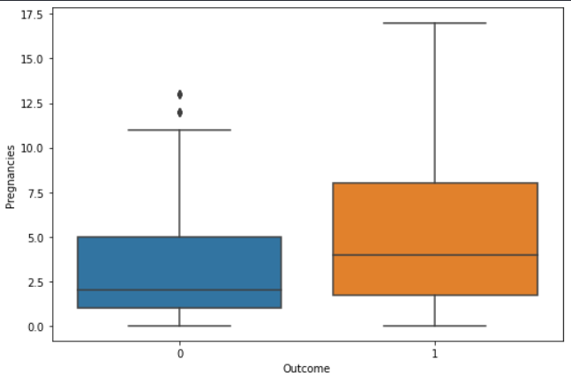
Major Findings
Number of pregnancies is a major predictor, especially when the number is high.

Slide 17
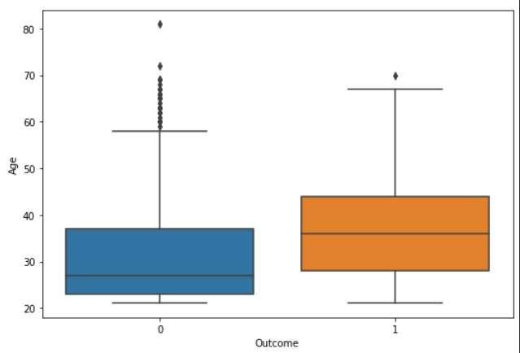
Major Findings
Age is a strong predictor. Women aged 38+ are more likely to be positive with an exception of numerous negative outliers.

Slide 18
Major Findings
Skin thickness and BMI are positively correlated.

Slide 19
Major Findings
Glucose and the outcome are positively correlated.

Slide 20
Dataset Splitting
01
02
03
Step 1
Step 2
Step 3
Splitting the dataset into dependent and independent features
Scaling the independent features
Splitting the dataset into training and testing set

Slide 21
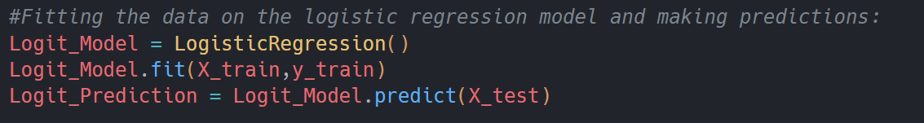
Modeling:
Since the dependent variable is binary in nature, logistic regression would be a suitable model to train.

Slide 22
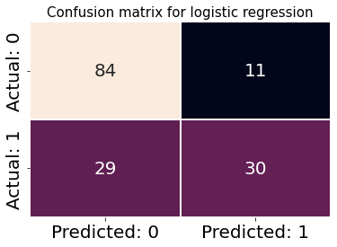
Confusion Matrix:

Slide 23
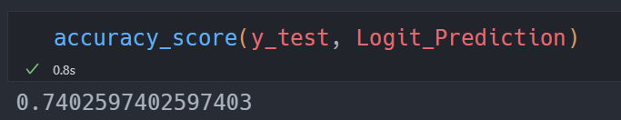
Accuracy Score:

Slide 24
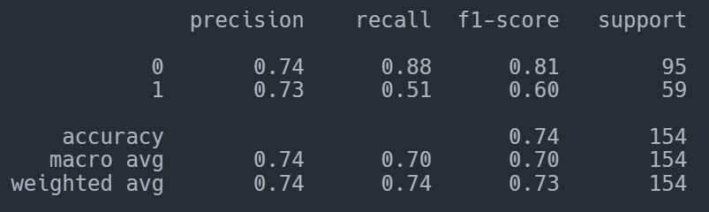
Classification Report:

Slide 25

K-Fold Cross Validation:
By using the K-Fold cross validation technique, we can see that the average accuracy of the logistic regression model is about 77.03% with a 3.89% standard deviation.

Slide 26
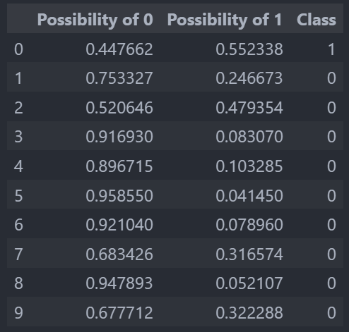
Test Data
Some outputs of applying the logistic regression model on the test data:

Slide 27
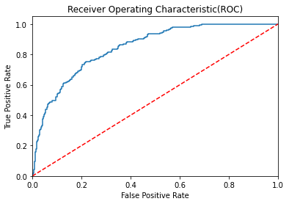
Receiver Operating Characteristic

Slide 28

THANK YOU
References:
Pima Indians Diabetes Dataset:
https://www.kaggle.com/datasets/uciml/pima-indians-diabetes-database

